Slide 1
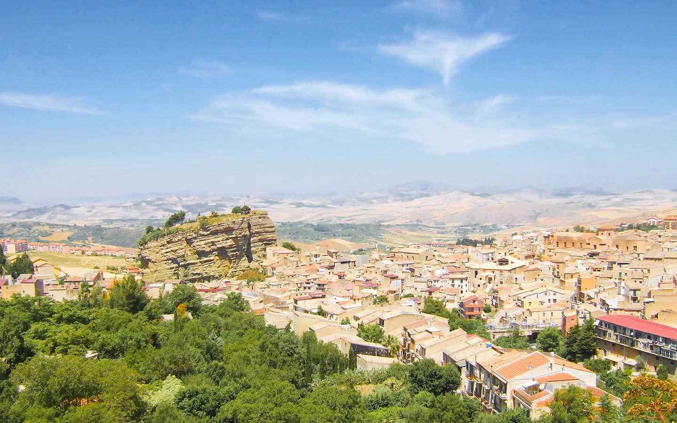

Corleone

Slide 2
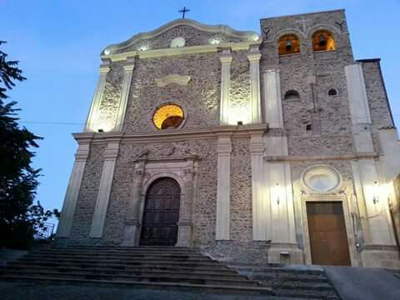
S.S. Salvatore
S.S.SALVATORE is a medieval sanctuary. Initially in the convent coexisted Benedictine and Carmelite sisters,
but this ‘marriage’ did not last long and , with the death of the abbess of the Carmelite nuns , stayed the
Benedictine sisters. The monastery organizes its factories around a cloister with a classically beautiful
octagonal fountain in the center, while the church , with a single rectangular nave, designed with a single
plastic- contained painting decoration, showed the monocle of Nicosia, depicting the Triumph of St.
Benedetto at the presence of SS. Holy Trinity between benedictines and carmelites Saints and an angelic c
horus.
Francesca Amato

Slide 3
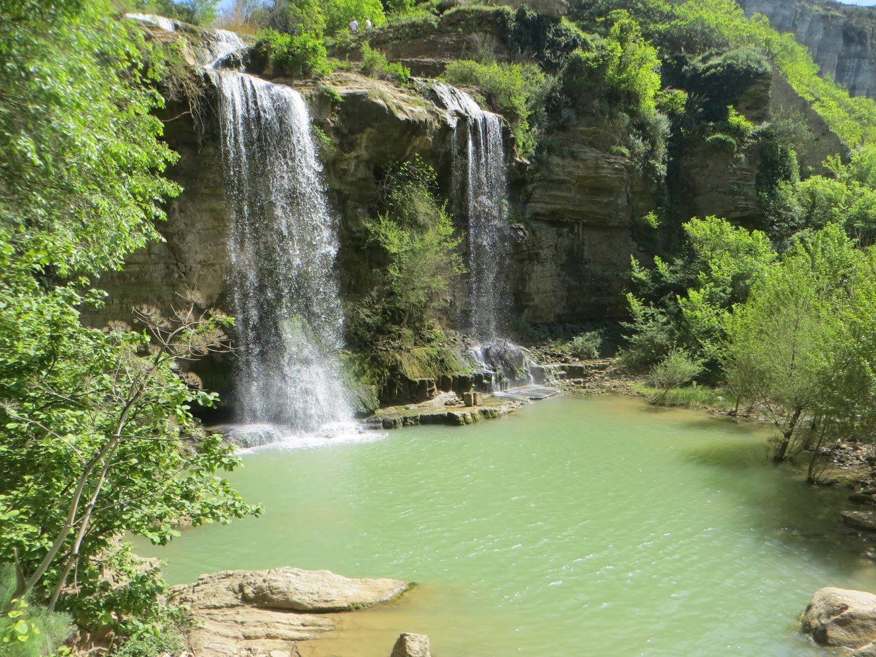
THE FALL OF THE TWO FORTRESSES
The Natural Park of the cascade of the two fortresses is a fantastic are. The waterfall is spectacular.
The waterfall of the river with its erosion has formed a large puddle in the calcareous rocks. In the pool,
covered with vegetation, there is a swarm of insects and amphibians and a going of birds come to drink. Around it there are the glauconitic rocks, brought to life by the erosion in their yellow- green color.Looking the walls there are the remains of an ancient aqueduct. Before jumping into this stream further upstream has explicate a strong action of excavation along the rocky sides forming the Canyon. There is a wonderful view. GOING back along the road leading up to the Falls of the two Rocks at the foot of which is set, in a picturesque landscape, the little Church of Madonna delle due rocche. It was built in 1651. Inside there is a picture of the virgin, which was in the chiesa madre before.
Giada Panzica

Slide 4
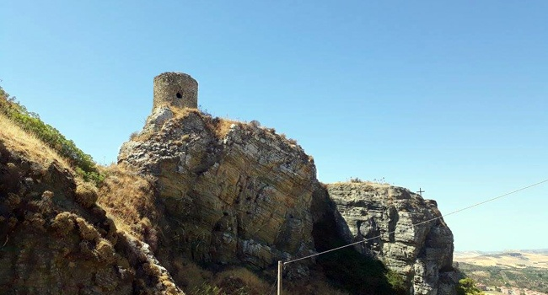
TOWER OF THE SARACENS
THE TOWER OF SARACENS or The ‘Soprano’ Castle dates from the nineteen century and of the it was built
as a watchtower of the Arabs to defend the city of Corleone . It is located on the rock in the east side of the
city and is constituted by a cylindrical volume covered by a stone dome. It dominates the town of Corleone
and it was built , with ‘Sottano or lower Castle, on the rock towards west, one of the two poles of reference
for the construction of the urban fabric of the city.
Giorgia Sorisi

Slide 5
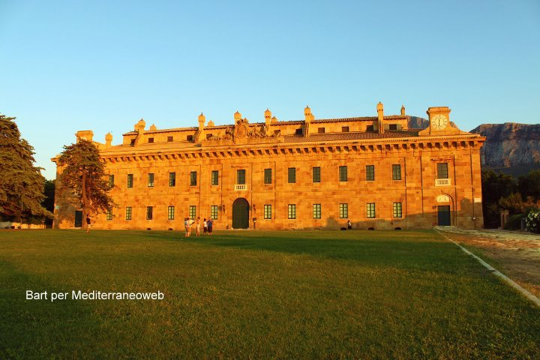
Ficuzza

Slide 6
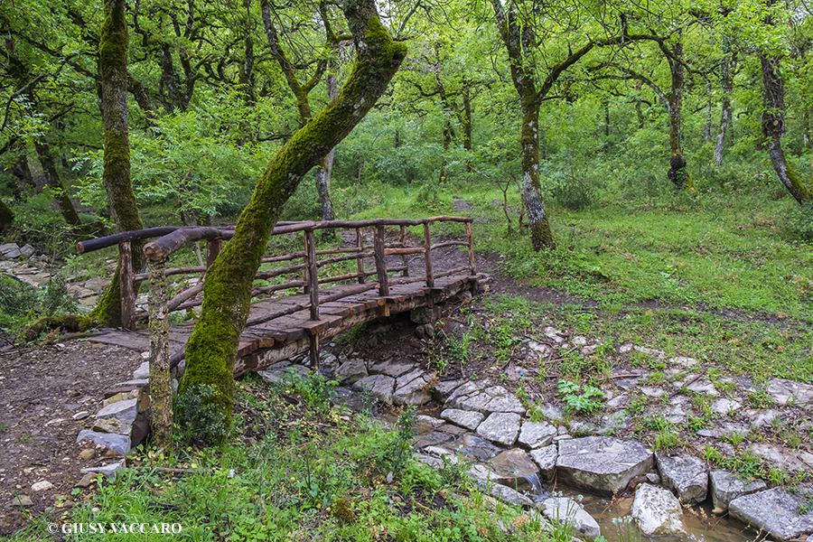
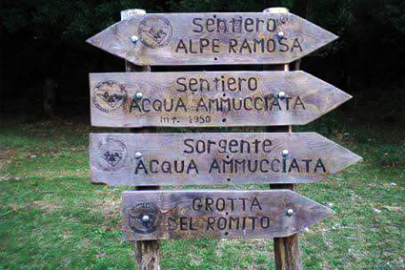
THE WOOD OF FICUZZA
NATURALISTIC ITINERARY THE WOOD OF FICUZZA
THE WOOD OF FICUZZA is very beautiful, majestic and rich in wild someone said to the Bourbon king that just get to Palermo from his lost Naples. So king Ferdinando IV decided to put his real site where he lives during the hunting seasons.Moved to Ficuzza , FerdinandoIV strove to build one of his greatest hunting reserves. The king endowed the forest with a road network and he worked to care for forest importing wild boar, fallow deers, and deers.He also wanted build in various places of the forest shelters for the keepers, farms and shelters for the cattle.
In the wood , we can admire the ‘pulpit of the king’ a stone throne where the hunter was lied in wait to shoot the hares and to deers.
Today it is a tourist destination. Because of its particular flora, wildlife, this area is declared naturalistic reserve wood of ficuzza and fortress busambra.
In all the seasons is wonderful and interesting visiting the reserve, because you have the opportunity to enjoy wonderful views .

Slide 7


REAL HUNTING HOME
It was built by the king Ferdinando IV of Bourbon, used as a royal hunting reserve,
his main passion. In neoclassical style, similar to the royal palace of Caserta, the
building , rectangular in shape, consists of a basement cellar once used to reserve food
a ground floor and a first floor. The roof of the hall is decorated with hunting
and mythological scenes, with figures of deers, wild dogs, floral shells, the goddess Diana
and the forest animals. The fireplaces are in Carrara marble.

Slide 8
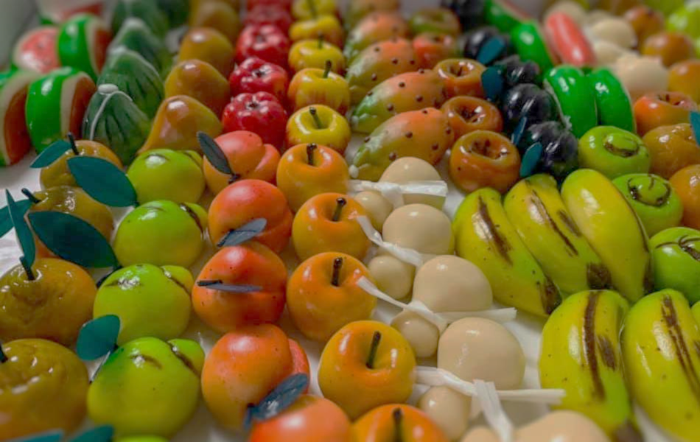

I CIBI SICILIANI
SICILIAN FOOD
I L
C A N N O L O
P A S T A
F I N O C C H I
E
S A R D E
L A
C A S S A T A
L E
A R A N C I N E
Ludovica Pasqua
Giada Panzica

Slide 9



I L C A N N O L O
Il cannolo siciliano è una delle specialità più conosciute della pasticceria siciliana.
Si compone di una scorza di pasta fritta e un ripieno a base di ricotta di pecora.
The Sicilian cannoli is one of the best known specialties of Sicilian pastry.
It consists of a fried dough peel and a filling made with sheep's milk ricotta.

Slide 10
L E A R A N C I N E
L'arancina è una specialità della cucina siciliana.
Si tratta di una palla o di un cono di riso impanato e fritto, farcito generalmente con ragù, piselli e caciocavallo, oppure dadini di prosciutto cotto e mozzarella.
Il nome deriva dalla forma originale e dal colore dorato tipico, che ricordano un'arancia.
Arancina is a specialty of Sicilian cuisine.
It is a ball or a cone of breaded and fried rice, usually stuffed with ragù, peas and caciocavallo, or diced ham and mozzarella.
The name derives from the original shape and the typical golden color, reminiscent of an orange.

Slide 11
L A C A S S A T A
La cassata siciliana è una torta tradizionale a base di ricotta zuccherata, pan di Spagna, pasta reale e frutta candita.
The Sicilian cassata is a traditional cake made with sweetened ricotta, sponge cake, royal pasta and candied fruit.

Slide 12
L A P A S T A F I N O C C H I E S A R D E
Pasta with sardines is a typical dish of Sicilian cuisine.
It is customary to prepare it for the feast of San Leoluca, patron saint of Corleone.
The main ingredients are sardines, pasta and fennel.
La pasta con le sarde è un piatto tipico della cucina siciliana.
E’ usanza prepararlo per la festa di San Leoluca, patrono di Corleone.
Gli ingredienti principali sono le sarde, la pasta e il finocchietto.

Slide 13
GRAZIE PER LA VISIONE
THANKS FOR THE VISION

