Slide 1

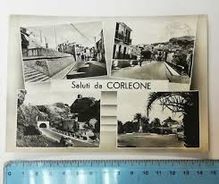
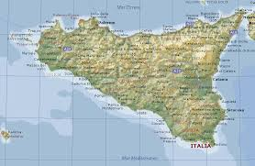
Scuola Secondaria di Primo Grado
G. Vasi CORLEONE (PA)
CONIGLIO DANIELE
FERRANTELLO GIUSEPPE
MACALUSO SALVATORE
RIINA GIUSEPPE
VERGA EMANUEL
We are here!!

Slide 2
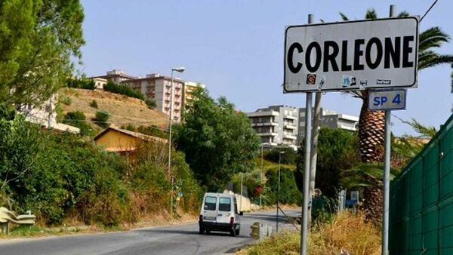
HI! Our names are: Daniele, Giuseppe, Salvatore, Giuseppe, Emanuel. We’re thirteen, we’re really nice and… we live in CORLEONE that’s a little town in SICILY (ITALY).
Notes:
Hi! My name’s Salvatore Macaluso, I live in Corleone …. In Sicily!

Slide 3


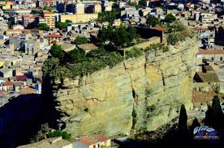
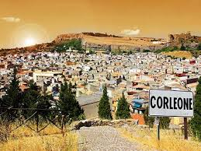
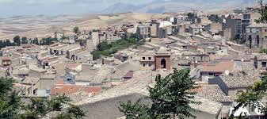
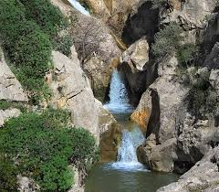
Our town
Corleone is a small town that has a population of about 11.000 inhabitants. It rises in an internal mountain area, in the basin between the "Rocca Ri Maschi", the Soprano Castle and the Underground Castle (seat of a former prison until the post-war period, today the home of the "Renovated Minor Friars").
Of natural interest are the Dragon’s Source near the Ficuzza wood and the Two Rocks Waterfall .

Slide 4

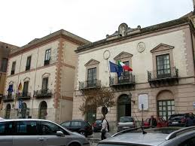
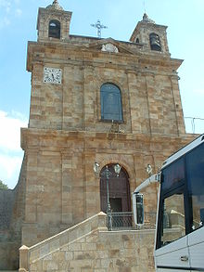
"Animosa Civitas", title conferred on it by Charles V on the occasion of his visit to Corleone in1556, was always at the forefront of all the wars that were fought in Sicily. It is not easy to go back to the origins, perhaps, because Corleone had various settlements since the most modest human groups were formed on the island. The various presences of these peoples: Sicani, Elimi, Phoenicians have been confirmed by the archaeological finds found.
Monuments and places of interest.
Sanctuary of the Madonna del Rosario in Tagliavia.
Continuing along the SS 118, to "Tagliavia", in the oasis of silence of the nineteenth-century sanctuary of the Madonna del Rosario, there are frescoes and paintings by Giuseppe Carta. A few more kilometers and you can visit the "Gole del Drago" (The Dragon’s Source) with the stones carved by the water of the river Frattina and with its luxuriant flora.

Slide 5
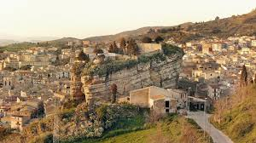
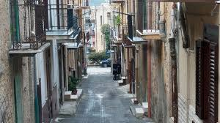
At the entrance to Corleone, the immediate impact is with its "twin" fortresses the Sottana, to the west, and the Soprana, to the east, on which the Saracen Tower stands. In the town you can admire the Chiaramonte portals of the Palaces and Churches of Via Cammarata and Firmaturi, the Baroque facades of the Churches and Palaces of Via S. Martino, the various bronze sculptures (statues and doors of Palaces and Churches) works by the Corleonese Biagio Governali. Along Via Bentivegna it is possible to admire the various "murals" depicting places and traditions of Corleone.
The main festival of the Corleonese people has been the feast of Corpus Domini since 1594, known as a fera ru Sacramentu. Every year the great fair is set up, the central moment of which is the procession of the Sacrament which is attended by all the brotherhoods of the country. On March 1st, San Leoluca, protector of the town, is celebrated with a procession and the lighting of bonfires. In May, then, there is the race of the saint, who renews the legend of San Leoluca who stops the Bourbon army together with Sant'Antonio abate.

Slide 6
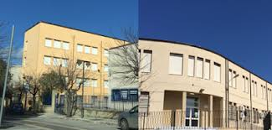
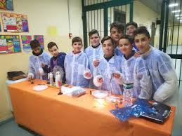
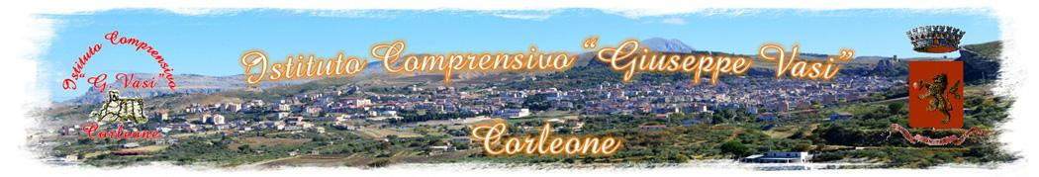
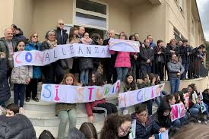
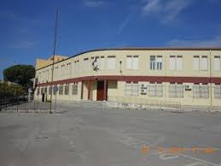
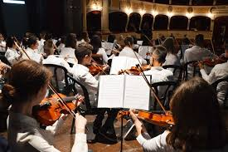
Our school
The "G. Vasi" 1st Grade Secondary School is home to the Territorial Center for Adult Education (CTP-EDA). Since the 2010/11 school year, the CTP-EDA has been mandated as a permanent education center. From the 2017-18 school year it becomes the “Giuseppe Vasi” Comprehensive Institute of Corleone (Palermo).
It is an institute where we are taught to study musical instruments: piano, violin, flute and guitar. We are part of the violin and guitar class.

Slide 7
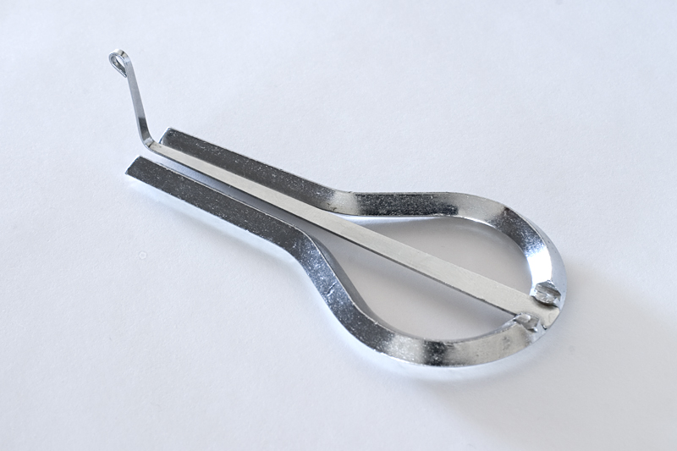
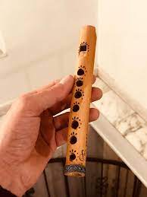
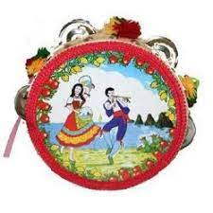
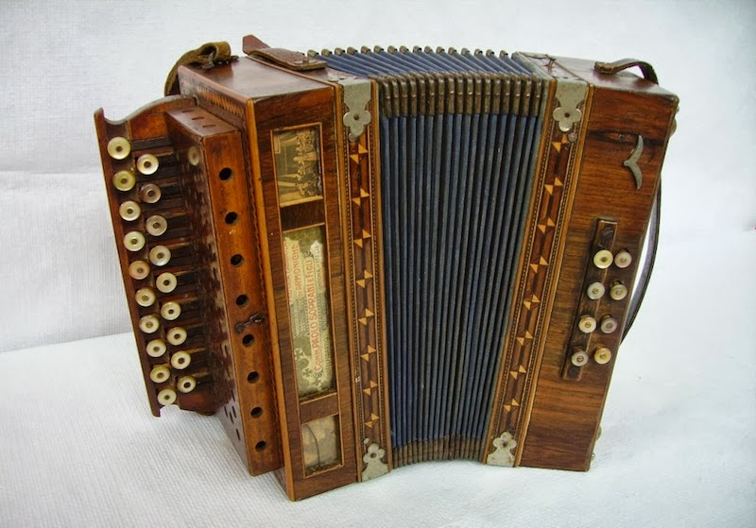
SICILIAN MUSIC AND FOLKLORE
SCACCIAPENSIERI (MARRANZANU - MARIOLU)
Popular Sicilian Music has roots that were formed over time with the succession of multiple cultures and civilizations. During the centuries of domination, the various musical traditions intertwined and merged and for this reason it is difficult to trace its origins.
Starting from the Greeks and Hellenic music, one of the main instruments of the island is the 'mariòlu', marranzanu or scacciapensieri. It seems to particularly resemble the lyra, an instrument imported from the Greeks, which we find not only in Sicily, but also in Calabria and Sardinia.
Another typical instrument of Sicilian folk music is the friscaletto or zufolo; it seems to have ancient pastoral origins. Then there is the zampogna (bagpipe) in addition to the tamburello (tambourine).
The organetto is a small accordion that was immediately successful, enlivening Sicilian festivals.
FRISCALETTO (ZUFOLO)
TAMBURELLO
ORGANETTO

Slide 8
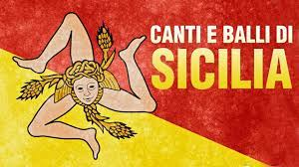
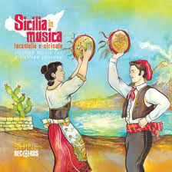
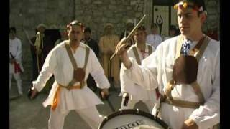
TATARATA’
In general, it is possible to say that the Sicilian folk song was born from the oral tradition. The songs were handed down from village to village, from town to town and took on a different aspect from time to time, giving rise to numerous variations.
A first musical typology linked to the Sicilian tradition is made up of work songs. They were performed during the daily work to better coordinate the various groups.
Finally, the songs of pain were performed without music and referred to the pain of those sentenced to death.
The Tataratà, an onomatopoeic voice that recalls the sound emitted by the drum, is one of the oldest Sicilian dances in the world. This dance is performed by armed men with swords and wreaths on their heads.

Slide 9
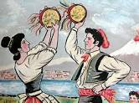
TARANTELLA
TARANTELLA
Tarantella is a dance full of energy, which is characterized by captivating and engaging rhythms, colorful costumes, tambourines and lots of joy. But what are its origins and how is the Sicilian tarantella danced?
The Sicilian Tarantella draws its origins from the Greco-Roman culture, with Gneo Nevio, who dedicated himself to the "Tarentilla", a comedy of Latin origins and Greek inspiration. The protagonist of this story is a girl from Taranto.
The term Tarantella derives from taranta, a word that indicated the tarantula insect, a poisonous spider. The ancients say that people who had been bitten by the poisonous spider danced the taranta.
Tarantella was danced in pagan public festivals, and following the Middle Ages, this frenetic dance rhythm was considered as a practice aimed at healing, a kind of exorcism with which demons could be driven away, which were represented by the poisonous spider.
Over time, the Tarantella has undergone several changes and has evolved into its function as a couple or collective dance, which is danced on various festive occasions.
During the 19th century, the Tarantella became one of the emblems of the Kingdom of the Two Sicilies, and its name thus replaced the names of some dances in various areas of Italy. In this way, Tarantella has become the best-known Italian dance in the world, so much so that it has even reached foreign borders.

Slide 10
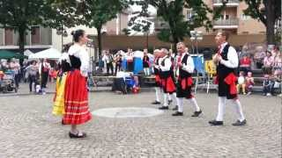
There are different typical Tarantella styles not only because they are danced or originated in different provinces, but because they are performed at particular times of the year.
There is a grape harvest dance, a carnival Tarantella or even a courtship dance…We remember:
Il ballo a chiovu that is a tarantella originally born among Sicilian peasants which was performed during the harvest period. This type of Sicilian dance is characterized by the fact that the feet, with a kind of hop, always beat in the same point.
Contradance that is a typical Sicilian dance that is performed during the Carnival period. Typically danced at village festivals and weddings.

Slide 11
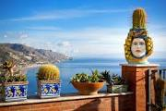
ERASMUS+
TEACHERS:
BELLARDITA GRAZIA
DI MICELI LUCIA
LA NEVE MARIA
TIRRITO DEBORA MARIA
PUPILS:
CONIGLIO DANIELE
FERRANTELLO GIUSEPPE
MACALUSO SALVATORE
RIINA GIUSEPPE
VERGA EMANUEL

