Slide 1
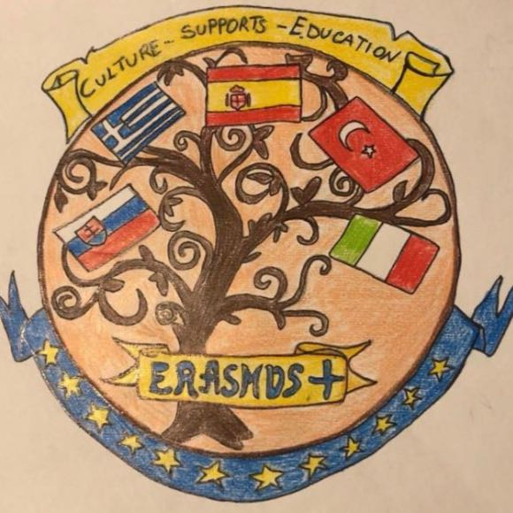
Erasmus +
Culture supports education

Slide 2
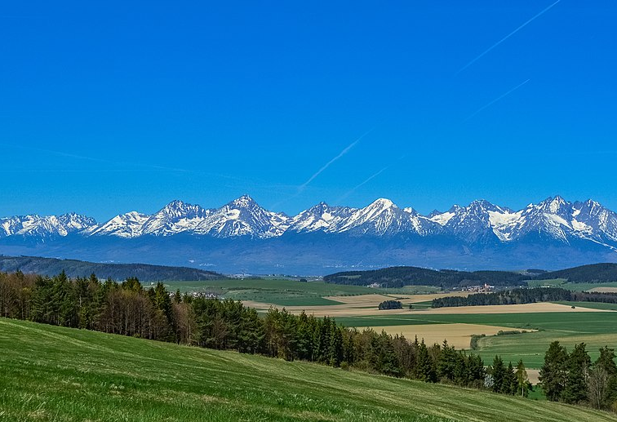
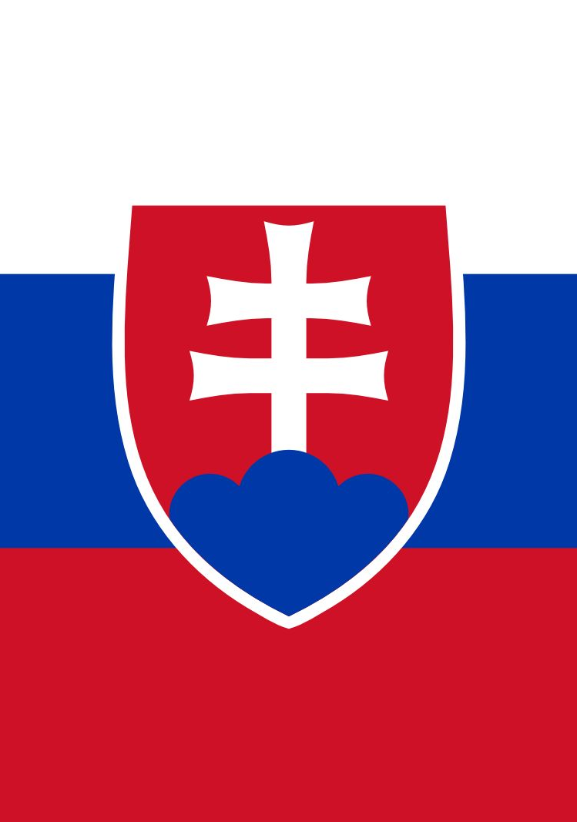
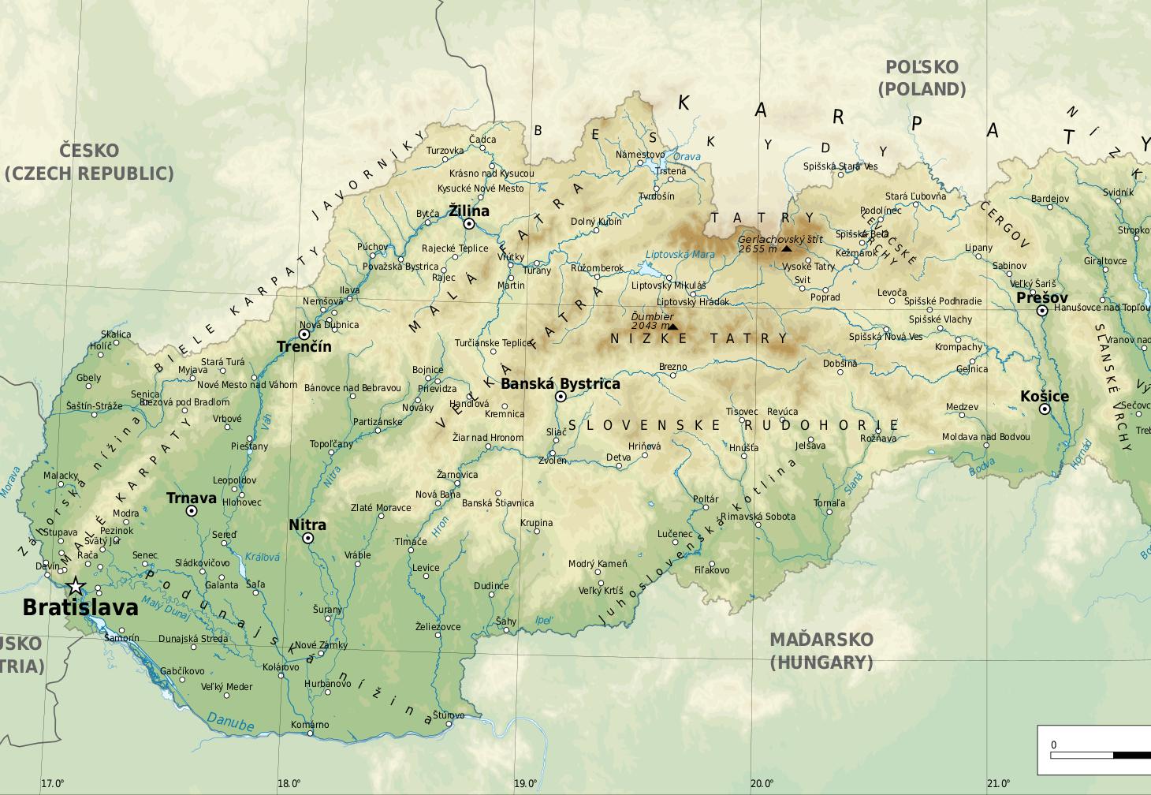
SLOVAKIA
Is a landlocked country in Central Europe
area: 49 036 km²
5 449 265 people
Our country is mostly mountainous
Our state was created after the division of Czechslovakia 1.1.1993

Slide 3
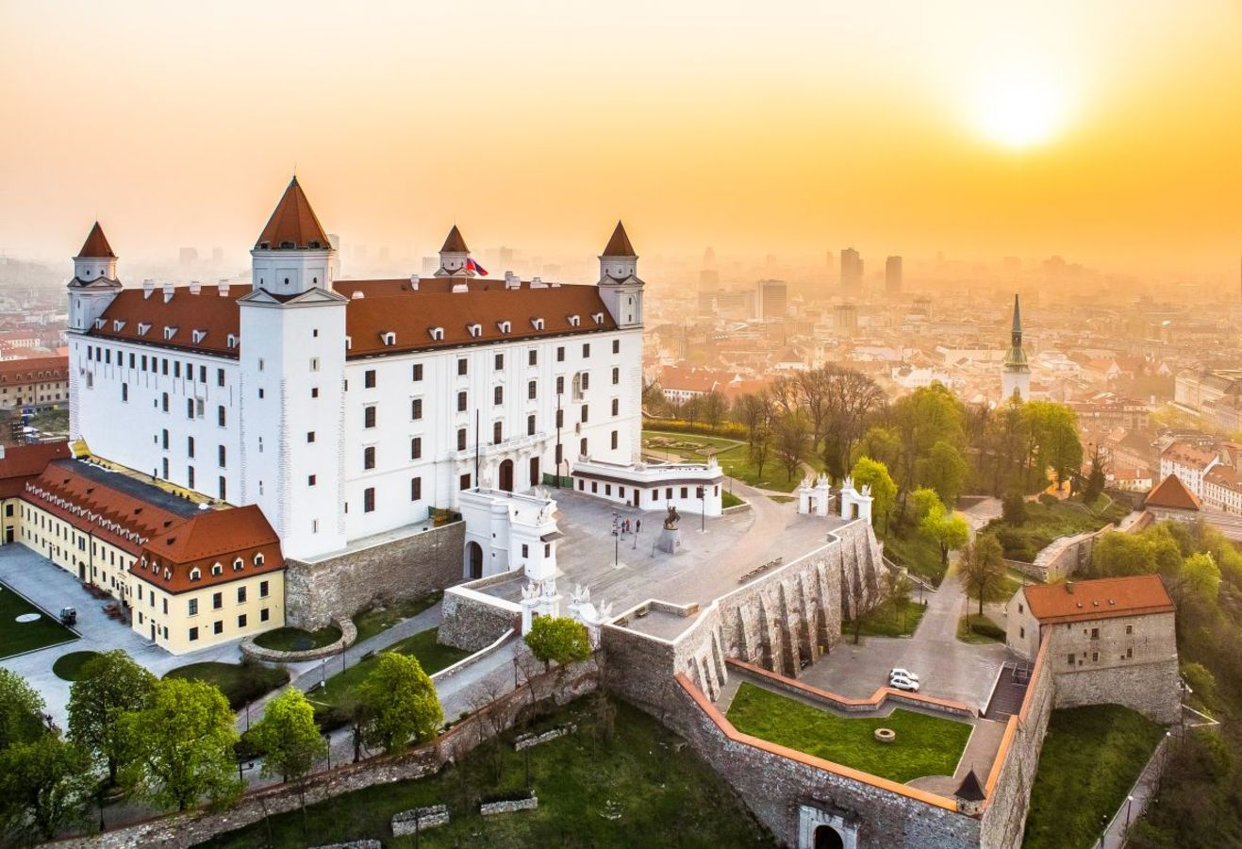
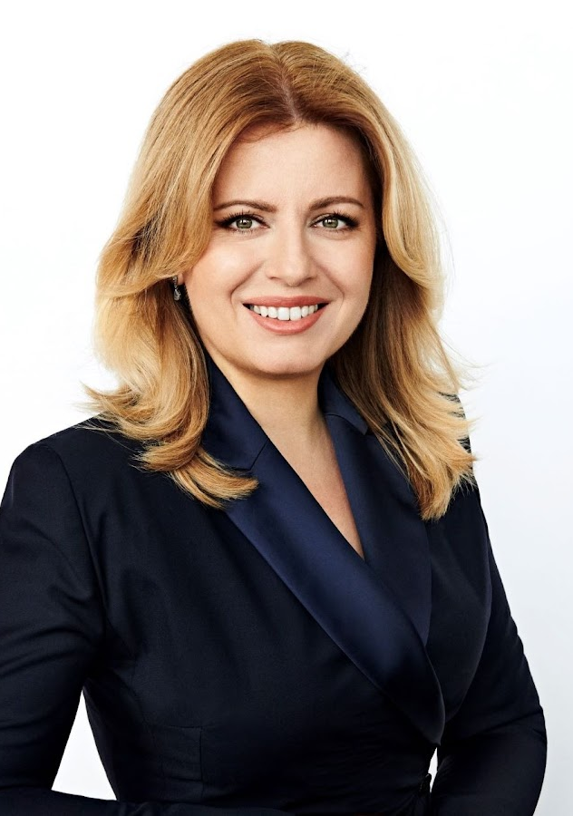
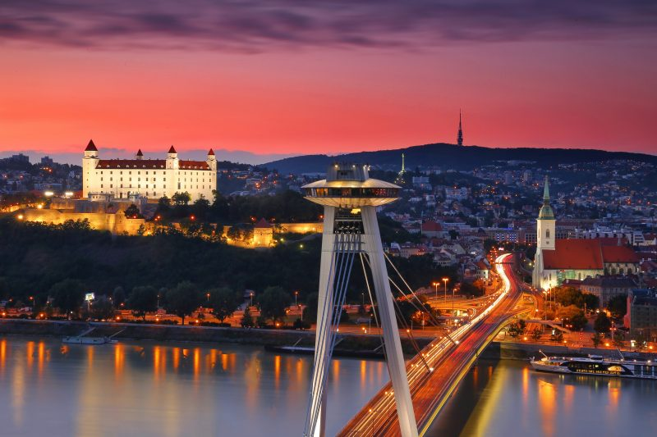
BRATISLAVA
The capital city of Slovakia is Bratislava
The Dunaj River flows through the city
It is the seat of the president, parliament and government
Bratislava Castle is dominates the city
The head of state is the president Mgr. Zuzana Čaputová

Slide 4
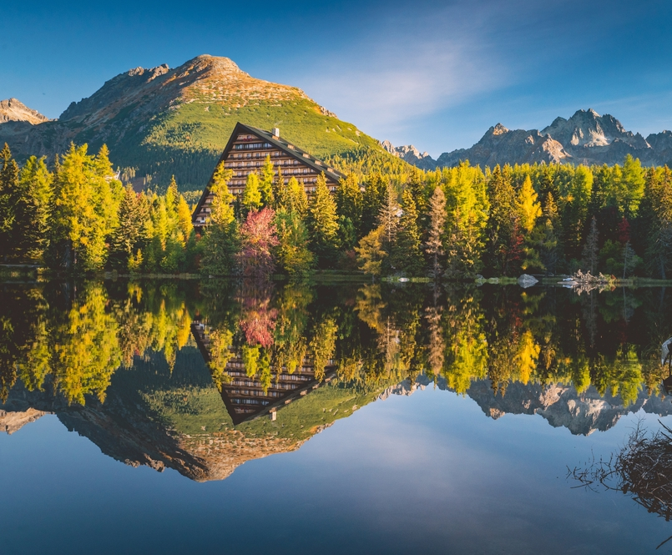
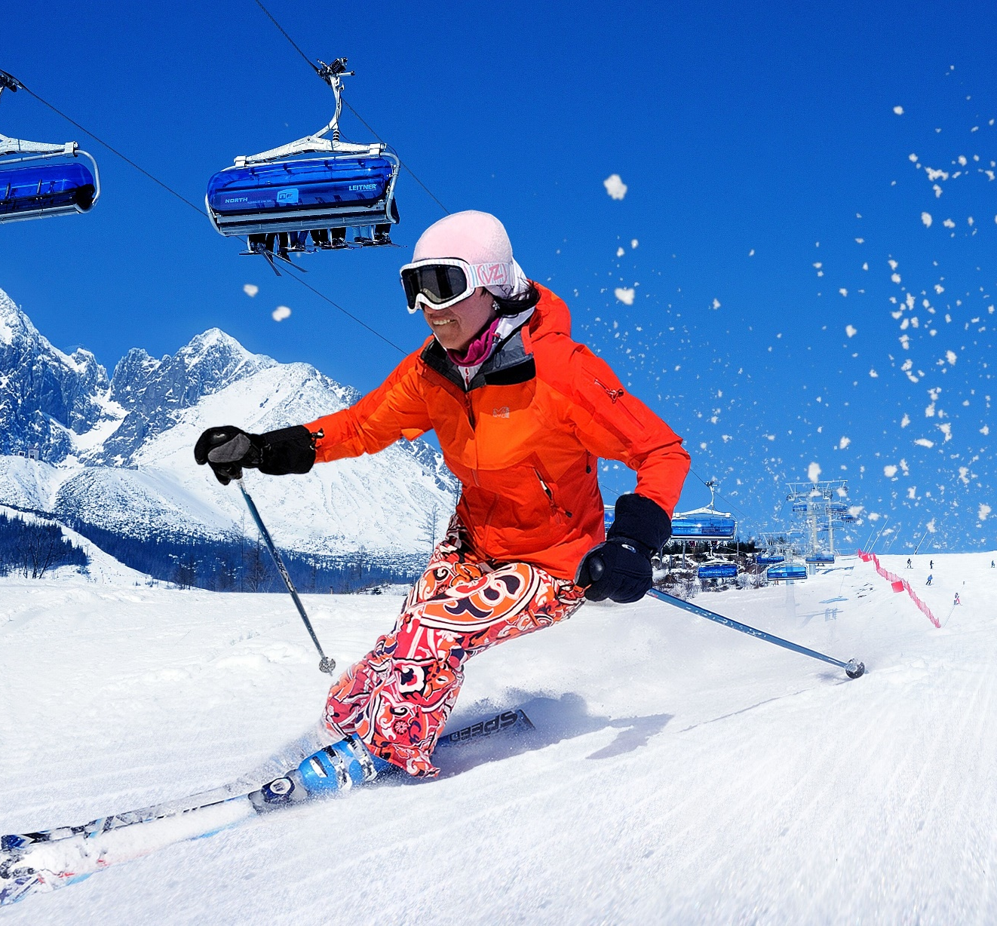
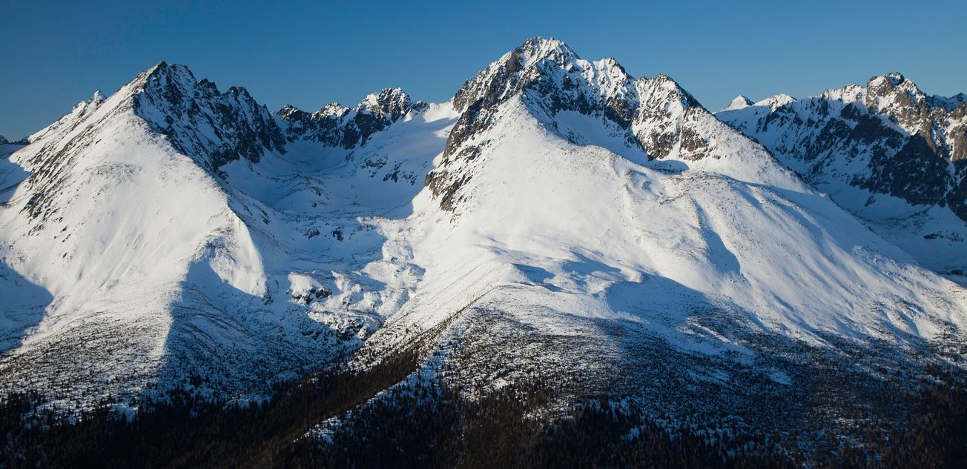
TATRAS
They are located in the northern part of Slovakia and form the highest part of the Carpathians
The highest Mountain is Gerlachovský štít. Altitude is 2 655 m
The Tatras attract tourists for skiing and tourism

Slide 5
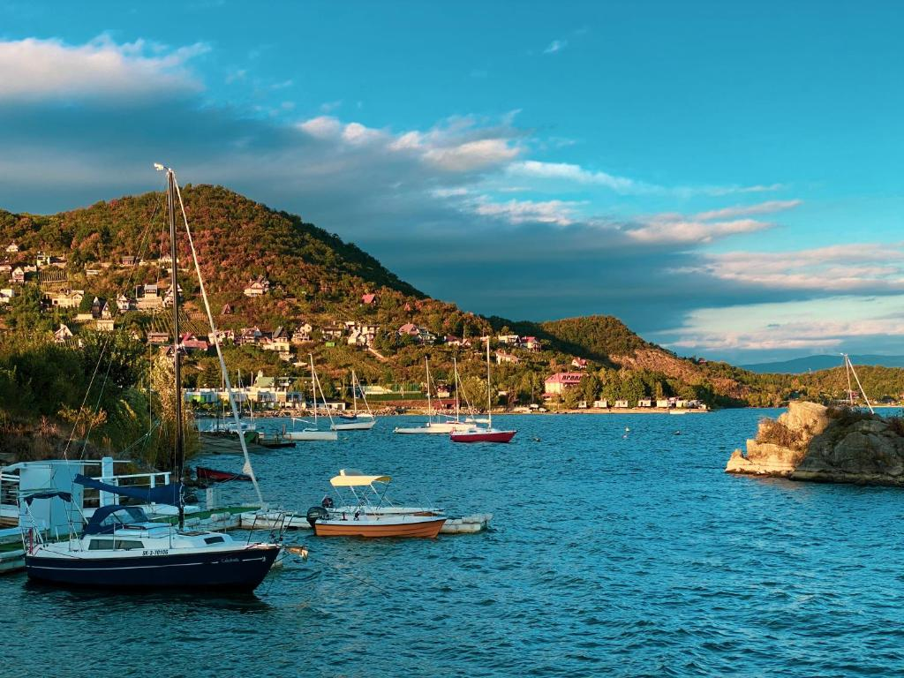
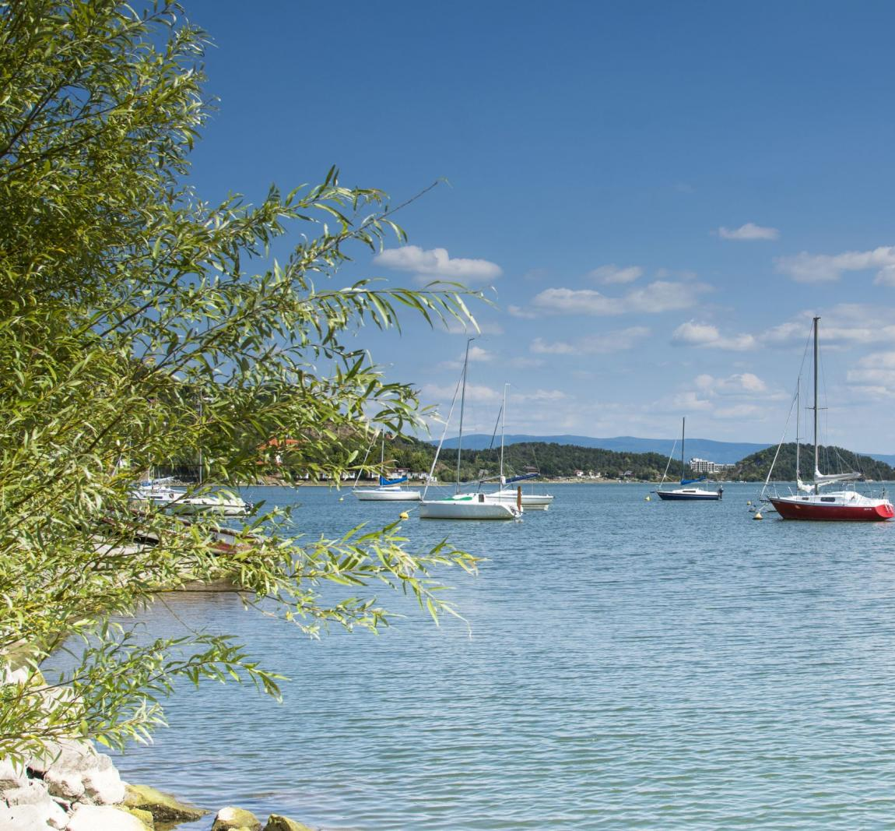
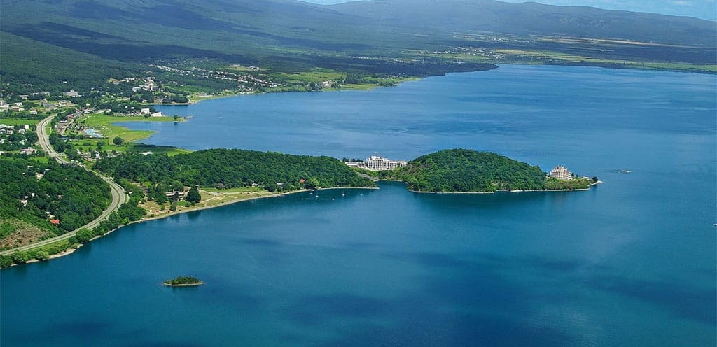
ZEMPLÍNSKA ŠÍRAVA
Water reservoir in eastern Slovakia
Popular tourist destination
In addition to recreation, it serves to irrigate agricultural land and protect against floods
The depth is 14,7 meters and the area is 33 km²

Slide 6
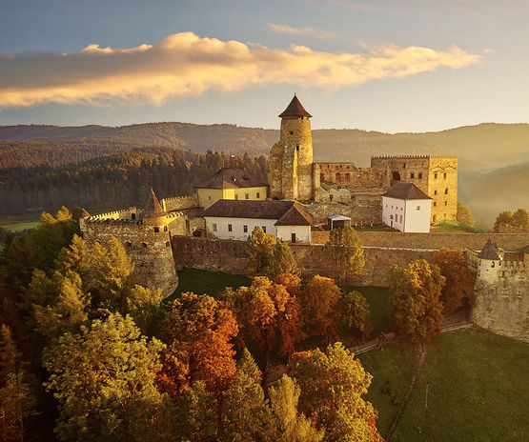
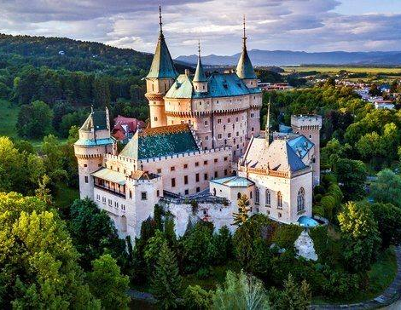
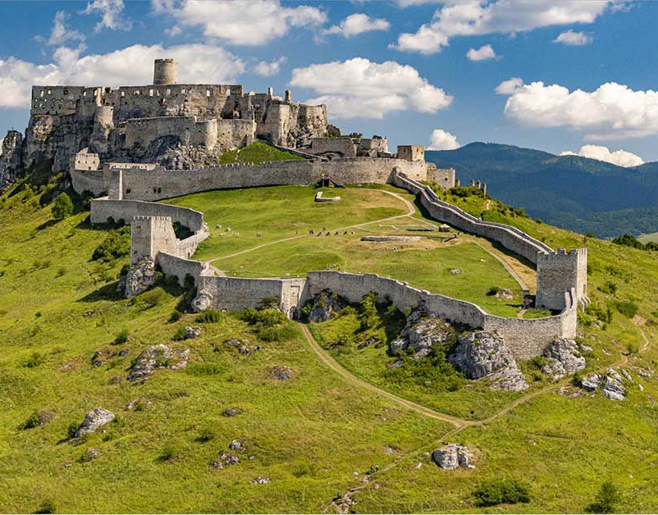
CASTLES
In Slovakia, we have majestic jewels that hide the secrets of the ancient past
Castles, mansions are an integral part of Slovak history
For example: Ľubovniansky castle
Bojnícky castle
Spišský castle

Slide 7
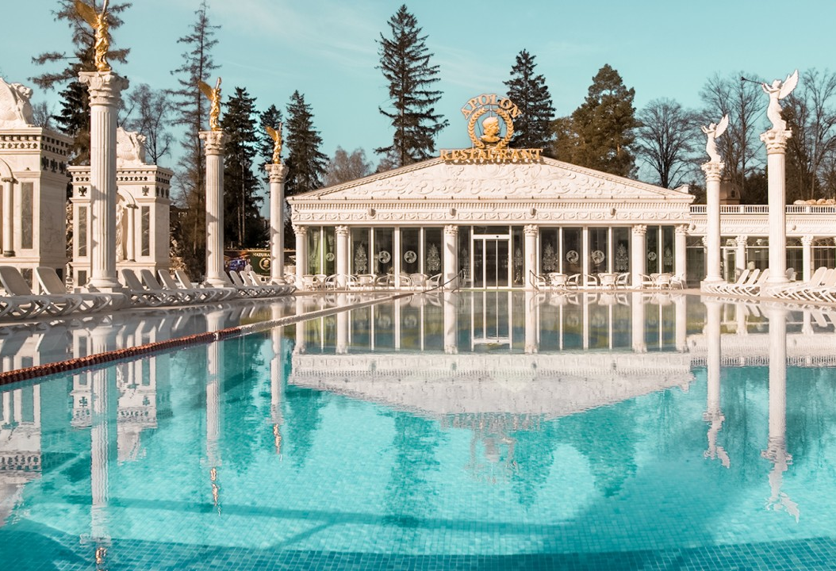
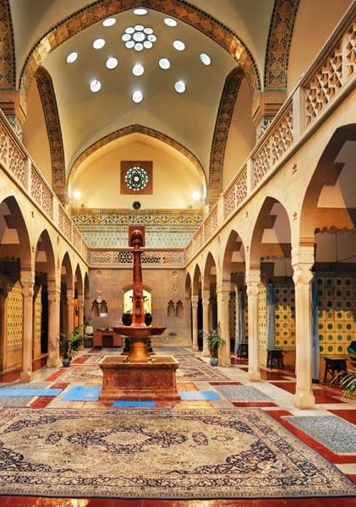
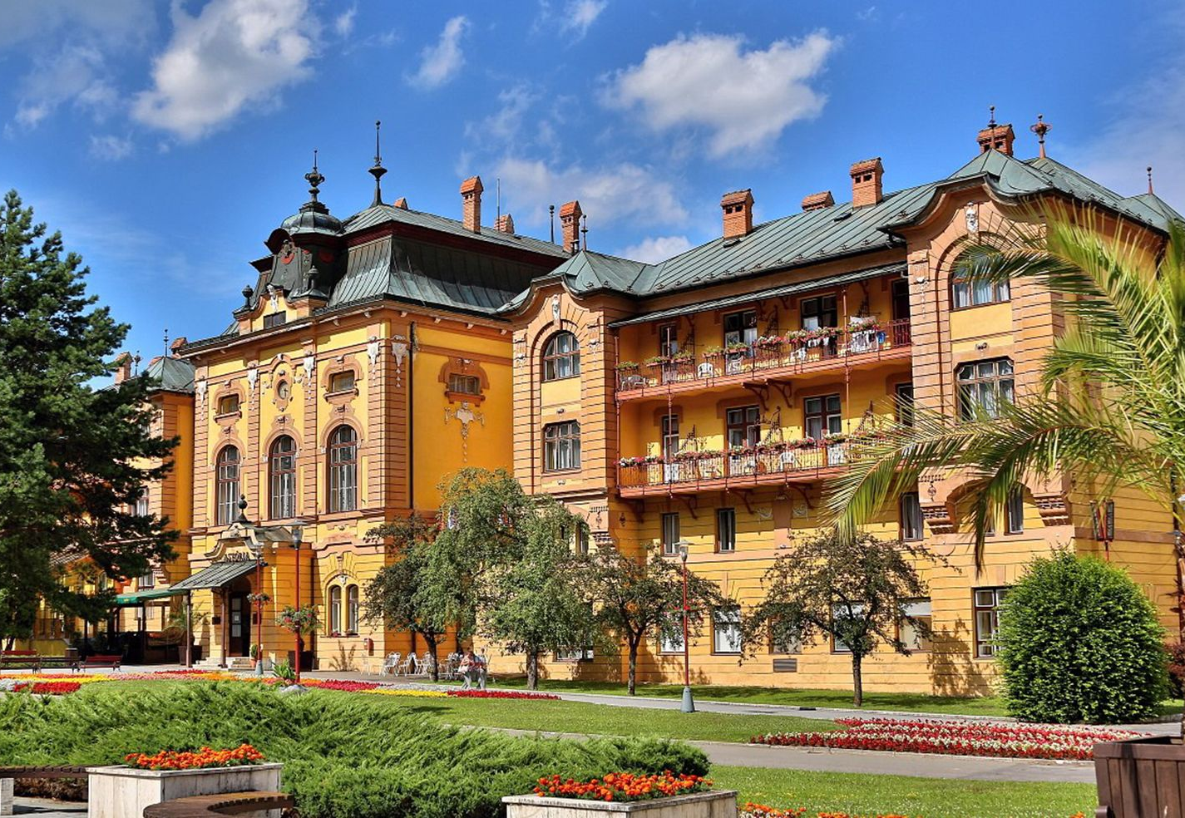
SPA CITIES
People visit spa cities for regenerarion and realaxtion. Our best spas are:
Piešťany
Bardejovské Kúpele
Trenčianske Teplice
Rajecké Teplice
Turčianske Teplice
Kúpele Dudince

Slide 8
Thank you for paying attention

