Slide 1
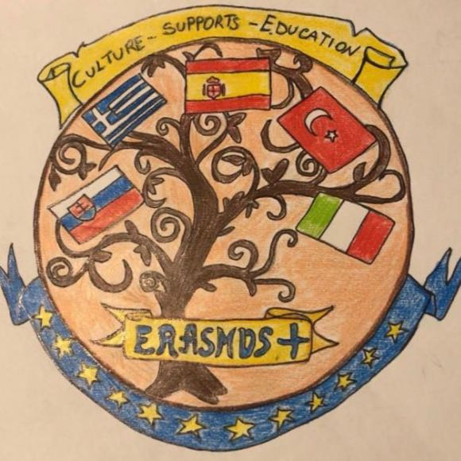
EraSmus+
CULTURE SUPPORTS EDUCATION

Slide 2
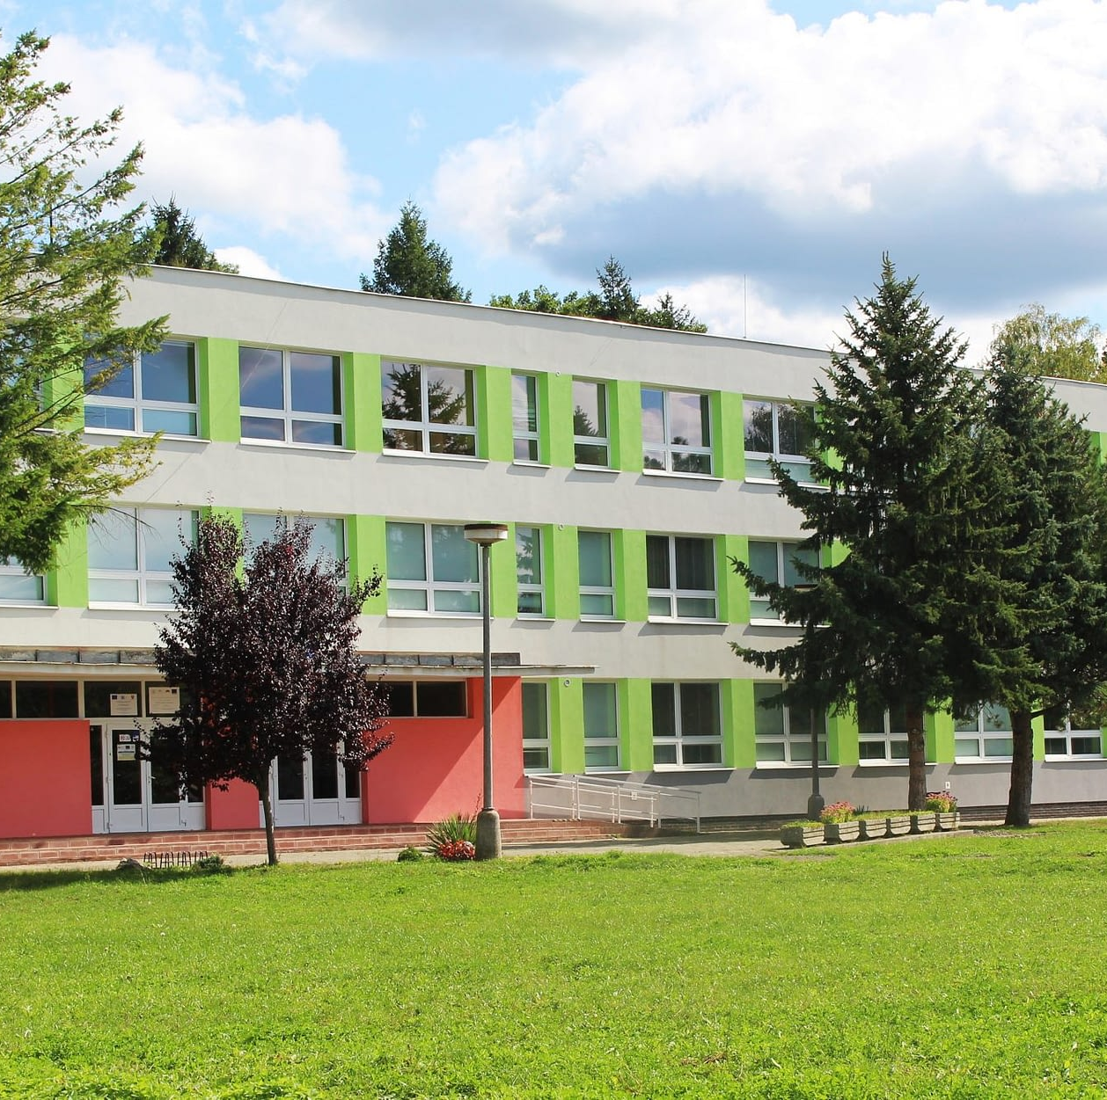
Elementary school kudlovská
Our school opened its gates 1. September 1977 and started to write its history.
Our school is situated in a beautiful area next to the park and castle.

Slide 3
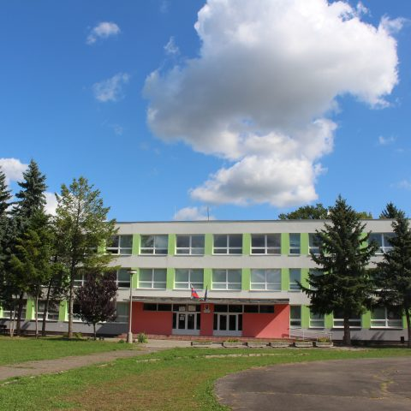
About our school
In our school there are 30 teachers and 9 teachers assistents.
There are 345 students in our school.
The principal is Mgr. Paulína Škerlíkova since 2. september 2017.

Slide 4
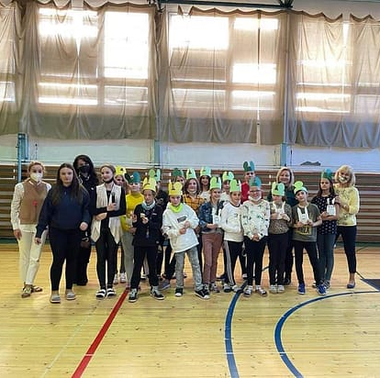
ušiačik
We attend elemetary school 9 years.
Students from 1st class to 4 th class are in first grade and then continue to second grade from 5 th to 9th.
For students moving from 1.st grade to second is made special party called Ušiačik.
So they are welcomed by older students.

Slide 5

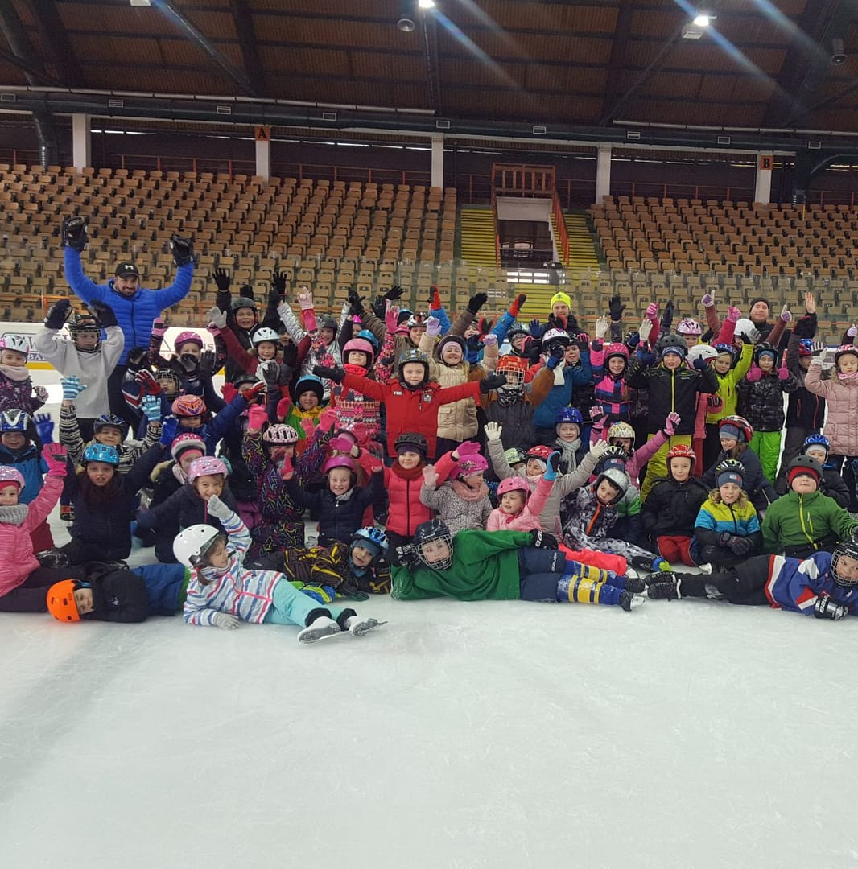
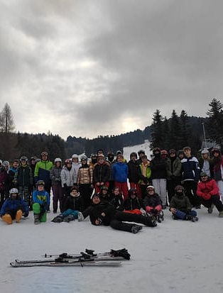
activities
Our school is orginizing a lot of activities for students.
For example ST. Valentines day, various trips to museums, libraries, and also sport activities (world run day).
We have a lot of courses,, too. For example skating course, swimming course and ski course.

Slide 6
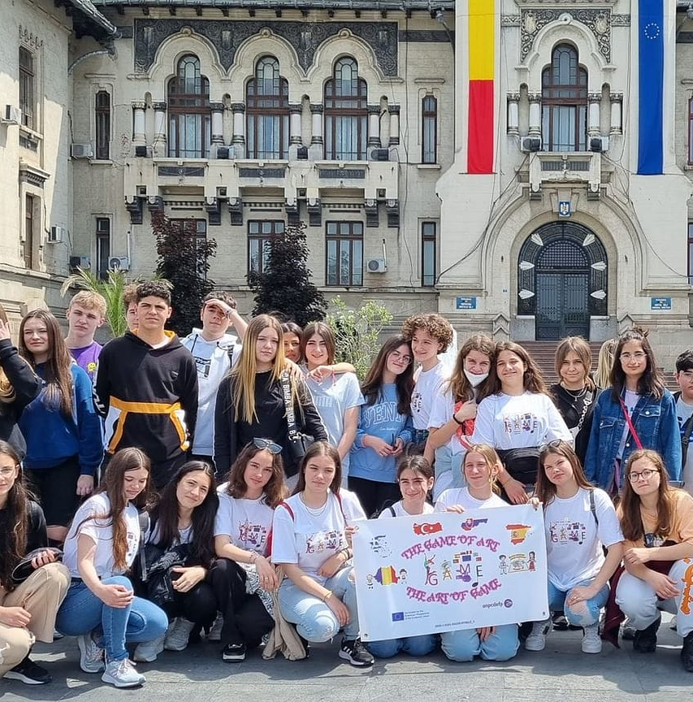
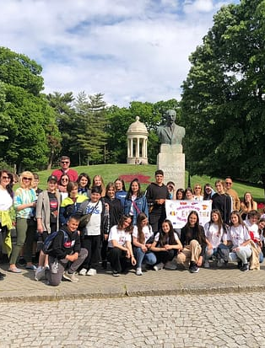
ERaSmus +
Our school takes part in Erasmus + project, too.
It is a very good project because it gives chance to students to meet and learn a lot about other cultures.

Slide 7


THAnk you for your attention

