Slide 1

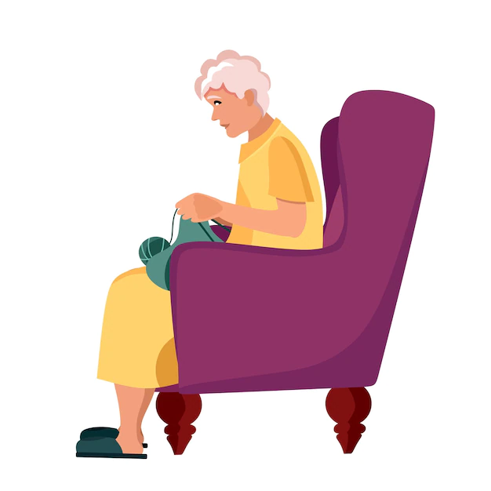
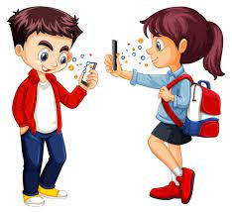
.
THE GAME OF THE PAST
A conversation between Francesco, Noemi and their grandmother Marina

Slide 2

Francesco and Noemi are all day with your mobile phone
We are playng grandma

Slide 3


Do you know any other games?
No grandma. Grandma, when you were a child, how did you play? Certainly, no with mobile phone

Slide 4


I played simple games and i was happy
What were the games of the past?

Slide 5

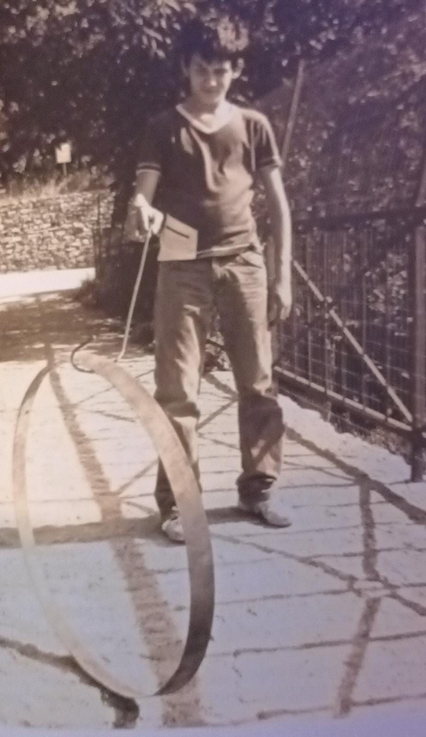

Once upon a time not all the cars of today and you could play in the street. I could freely play on the streets and exploring the empty spaces was a greatpart of our games. The most common games were: O’ CICCO’
WHAT?

Slide 6


THE CIRCLE. IT WAS A CIRCLE OF IRON, CARVED FROM THE BOTTOM OF A METAL BUCKET. THE PLAYERS HAD TO PUSH IT WITH A BIG IRON WIRE ON A PATH. WHO ARRIVED FIRST TO THE GOAL PREVIOUSLY ESTABLISHED, WAS THE WINNER.
Wow fantastic!

Slide 7
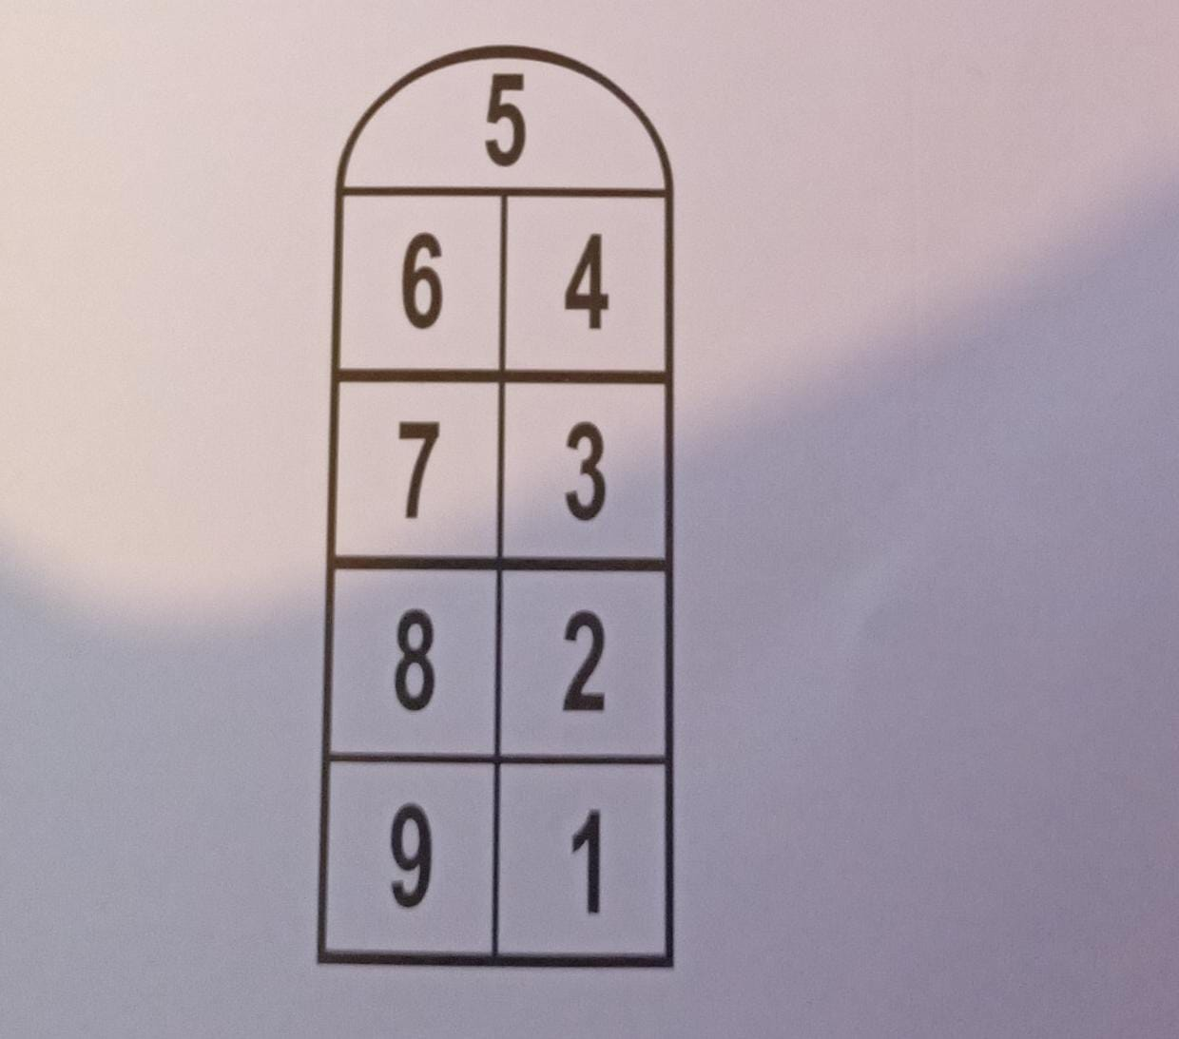

Another games was ‘u zuppareddu siciliano’
What? Translate please!

Slide 8
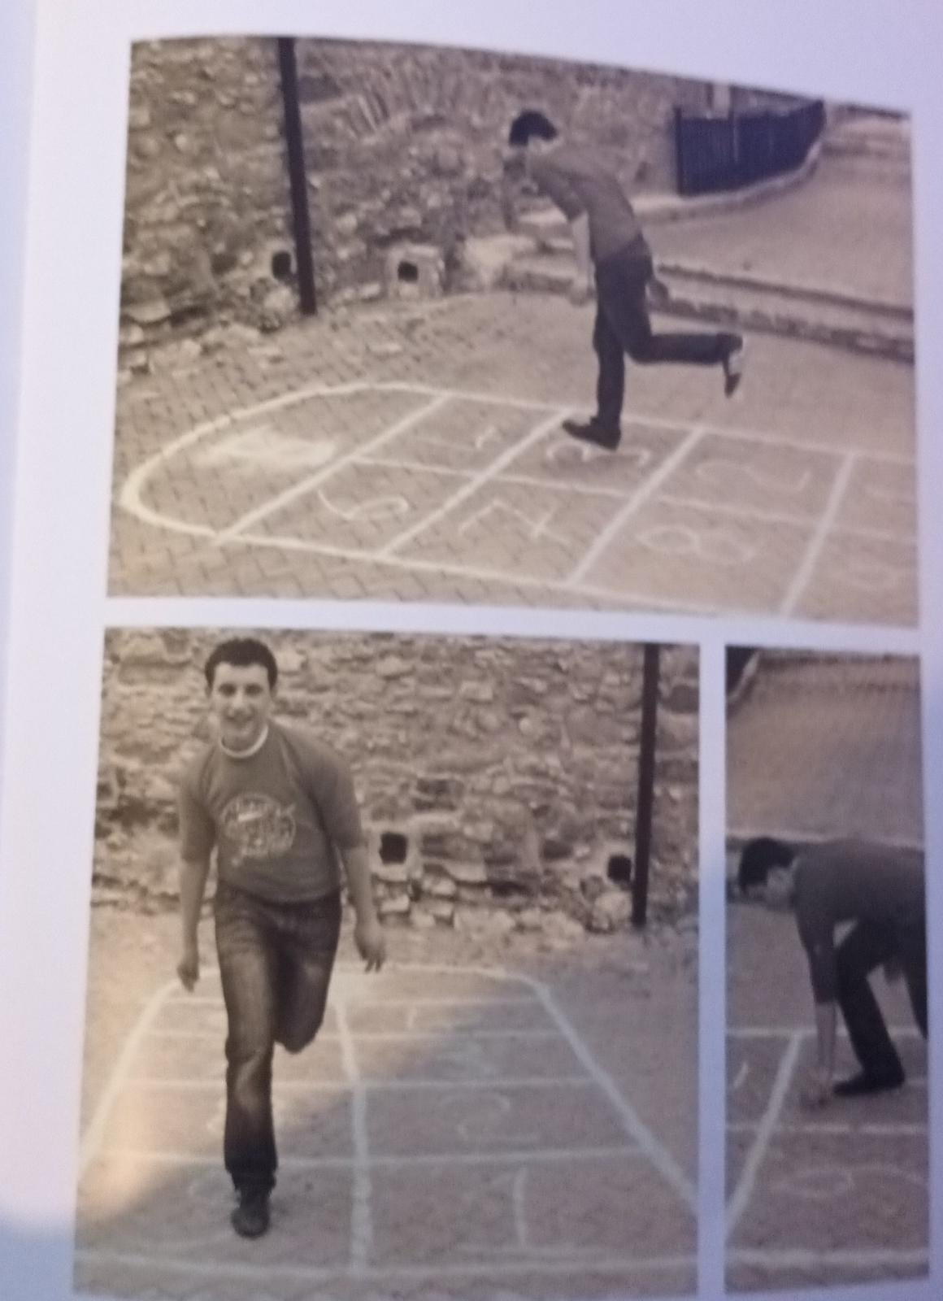

It drew a large rectangle with chalk on the road and inside were written the numbers from 1 to 10. who could jump with one foot was the winner

Slide 9

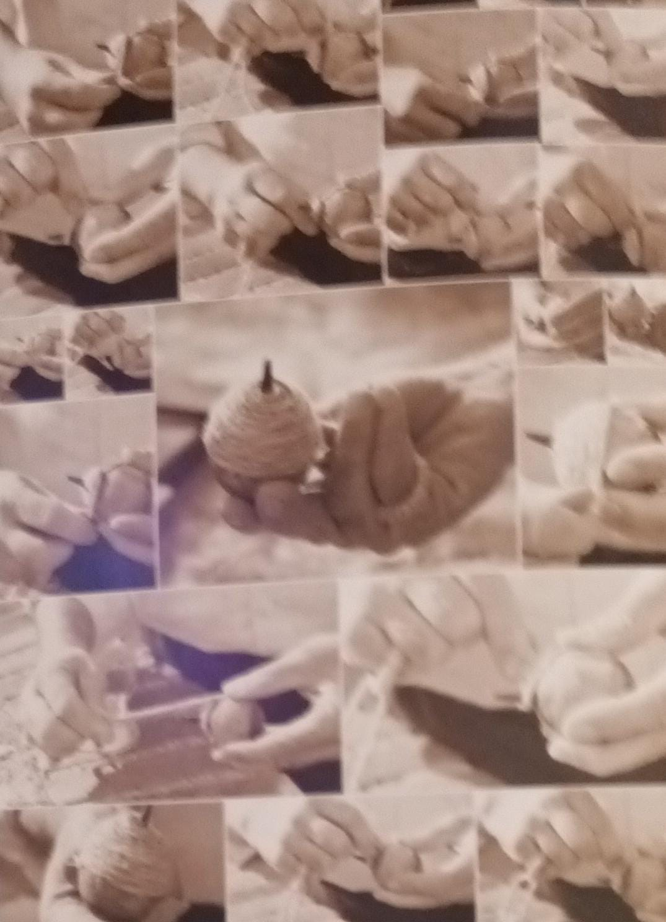

Another game was the «buccino» today the spinner. It was made by a woodwn ball, with a pointed iron appendix stuck in the sphere and a hemp cord. The player wrapped the string around the ball and threw it forcefully on the ground. This began to twirl on the ground on the tip. Who was good, he could take it from the ground with the palm of his hand and made it to twirled it on it
We are speechless grandma, what a wonder.

Slide 10

Another game were i ciappeddi
Grandma what a strange name. what it was?

Slide 11

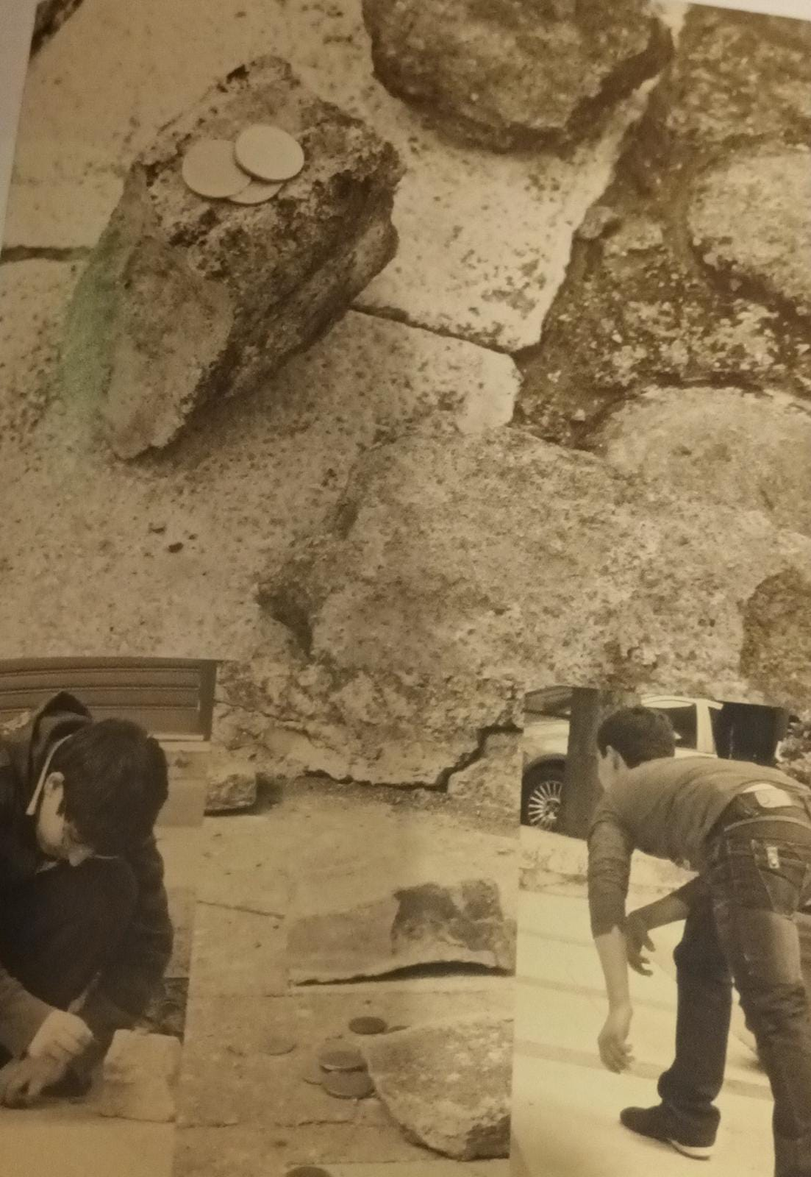

IT PLAYED WITH FIVE ROUND STONES (THE BETTERWERE THE ROUND STONES OF THE RIVER) AND DIFFERENT PLAYERS. IT WAS PLAYED ON THE STREET AND SIDEWALKS WITH PLAYERS SQUATTING., A FIELD WAS CREATED AND AT THE OPPOSITE END THERE WAS A STONE. THE PLAYER THREW THE STONE AND IF HE HIT THE ONE PLACED AT THE END OF THE FIELD, MAKING IT SWIRLING ON THEGROUND, HE WON.

Slide 12
As you see, dear grandchildren, we played with little but we were happy.
Francesco Mancuso
Laura Noemi
III C

